Slide 1
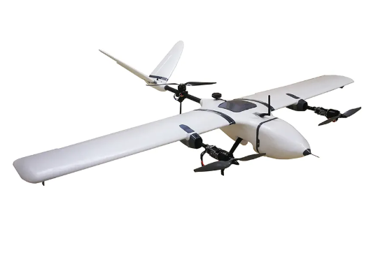
Vertical Take-off Landing (VTOL) Aircraft
Metin Öz Harun Üner
2019405207 2019405207

Slide 2
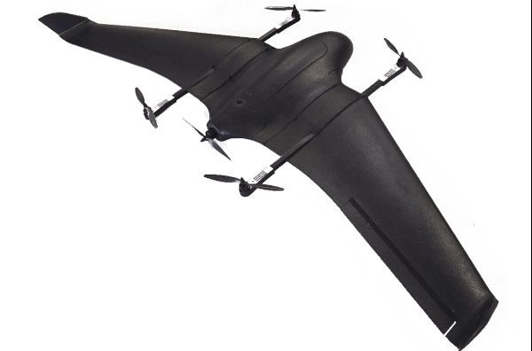
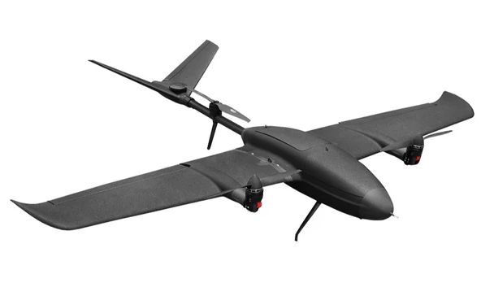
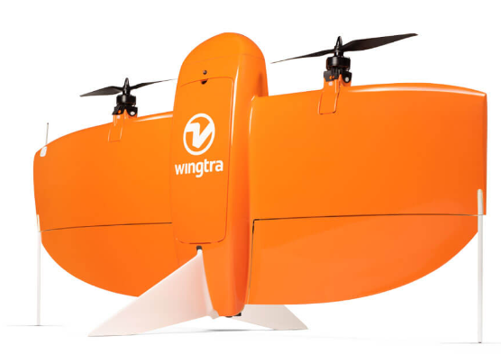
What is VTOL?
-The Use of VTOLs and their advantages to conventional air vehicles
-The Main Types of VTOLs :
Quad-in-Plane VTOL drones
Tailsitter VTOL drones
Tiltrotor VTOL drones

Slide 3

Functional Requirements :
Semi-Autonomous Flight
Tilt Rotor mechanism
Stall Speed: 8-10m/s [$V_{Stall}$]
Cruise Speed: 10-13m/s [$V_{Cruise}$]
Take-off Weight: 1000-2000gr [$M_{to}$]

Slide 4
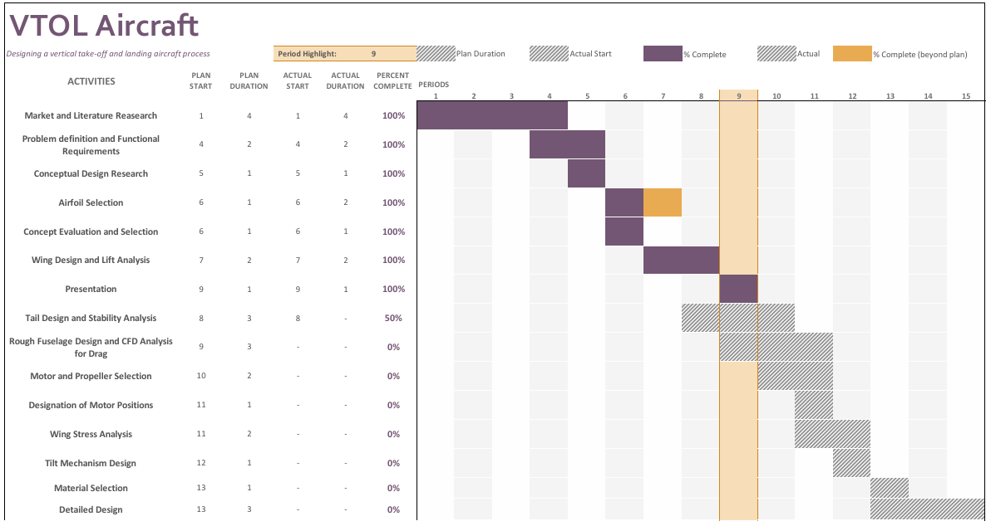
Gantt Chart

Slide 5
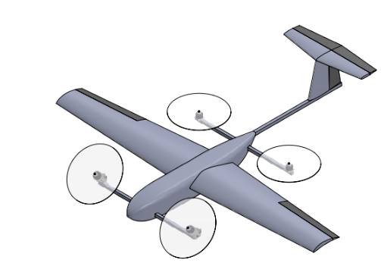
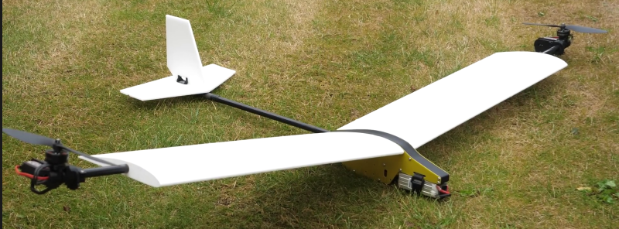
Concepts of Fixed Wing VTOLs
Concept 1
Concept 2
Concept 3

Slide 6
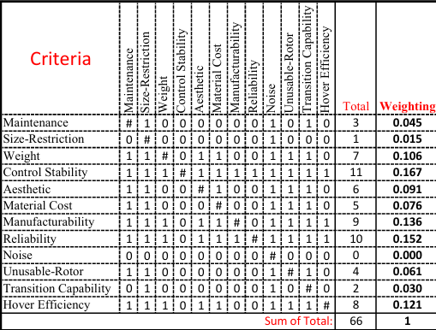
Binary Dominance Matrix

Slide 7
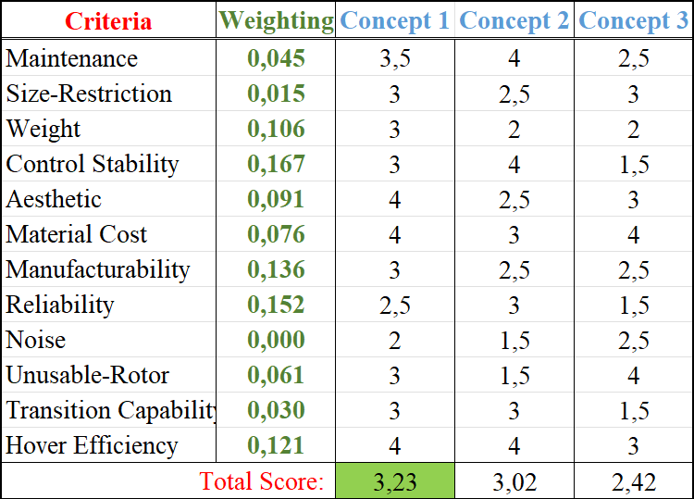
Concept Evaluation

Slide 8
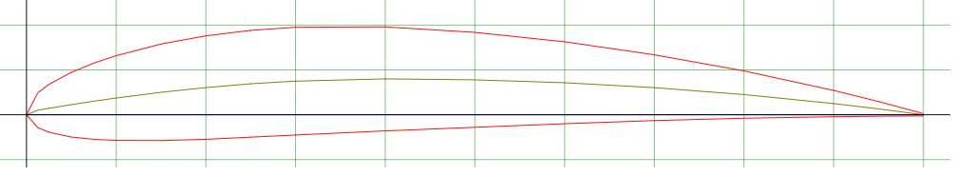
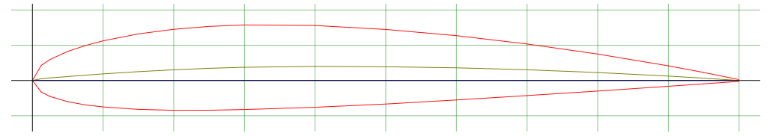
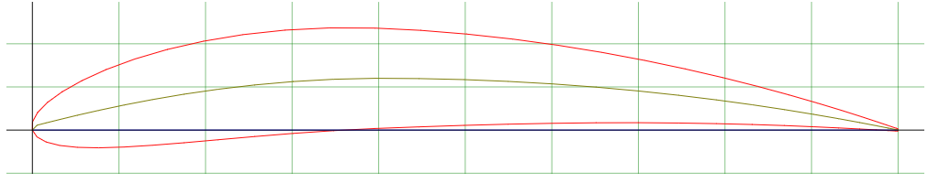
Airfoil Selection
NACA 4412
NACA 2412
NACA 6412

Slide 9
Wing Design and Lift Analysis

Slide 10
Tail Design and Stability Analysis

Slide 11
Foto referansları px4 , wingtra

